Slide 1

NETWORKING:
How to land a job through networking
Notes:
This is kind of a lie, you might still have to press apply

Slide 2
Agenda
Background
Where to find the humans
The Intro
The Meeting
The Follow Up

Slide 3





Background
I got almost all my jobs through networking

Slide 4
Why is networking important for my job search?
You just left a music festival that you drove to, out in the middle of nowhere, when you hear that all the trains out of town are shut down until further notice. Everyone is asking you for a ride! You have one seat in your car, who do you take:
Your best friend
A person you met at the music festival that you really vibed with
A random stranger who asks for a ride

Slide 5
Why is networking important for my job search?
Now let’s imagine you have two seats left in your car, then who would you take?
Your best friend
A person you met at the music festival that you really vibed with
A random stranger who asks for a ride

Slide 6
Where to find the humans
How do I know who to network with?

Slide 7
What to look for
Interests
Does this person seem interesting to you or have similar interests as you? This does not just have to be professional.
Example: You love to cook and you heard a person at an event mentioning their favorite recipe.
Example: You’re interested in accessibility in tech and you see someone post on Linkedin about a new closed captioning app they created.
Background
Does this person have a background similar to yours or have a background that you want to learn more about?
Example: You went to a bootcamp and you see that someone on Linkedin also went to a bootcamp.
Example: You are interested in data science and see an event attendee is a data scientist
Offering
Does this person have something to offer you and do you have something to offer them (even it it is in the future)
Example: They can offer you insight, collaboration, or even a job!

Slide 8
Where to Look
Linkedin
Angelist
GitHub
Slack
NYC Coders
Ladies Get Paid
iOS Developers
Events
Friends of friends

Slide 9
The Intro
How do I make the first move?

Slide 10
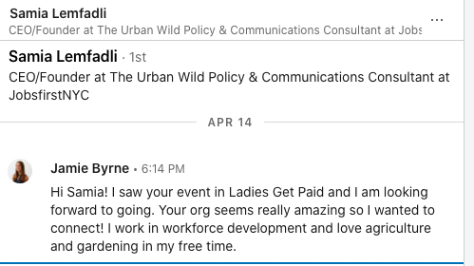
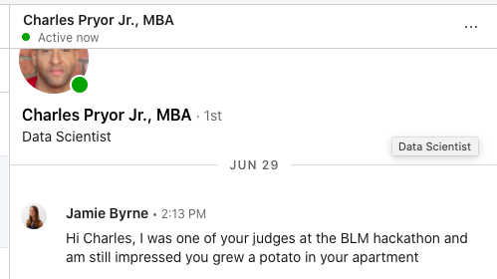
Cold Outreach
Who are you
Why them?
What do you want?

Slide 11
Events
Introduce yourself and a small “pitch”
Why did you approach them?
For virtual events - pay attention to the panelist and guest list so you can reach out after!

Slide 12
The Meeting
What do I say?

Slide 13
How to lead the conversation
1:1 Networking
- Have a plan of what you are looking to get out of the conversation. NOT just “picking their brain”
- Lead the start of the conversation with why you connected with them and where you want the conversation to go.
- Ask questions!
- Let if flow where it flows
Events
- You don’t have to do your whole pitch at once
- Make the conversation about them
- Don’t be afraid to go off topic and have fun.

Slide 14
The Follow Up
Where do we go from here?

Slide 15
The Follow Up
Add them on Linkedin or send a follow up email if you have their email
Remind them who you are and remind them what you talked about.
Reach out to them when you see something that interests them, to check in, to congratulate them, to update them.
Then - ask for them to recommend you for a job!

Slide 16
Questions?

